Slide 1
Business Outreach Luncheon
June 21, 2023
Notes:
Enter Month and Date

Slide 2


Slide 3
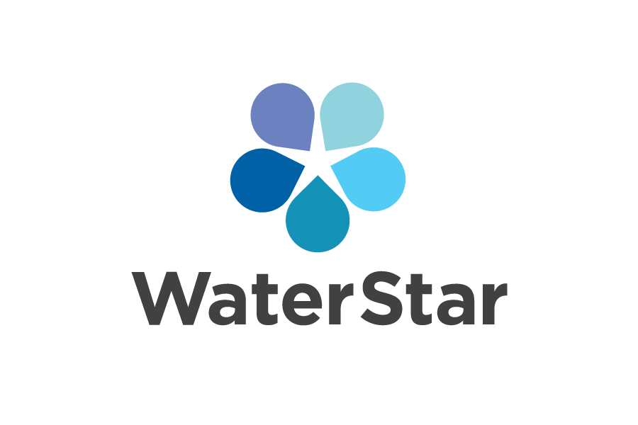
BUSINESS RECOGNIATION PROGRAM

Slide 4
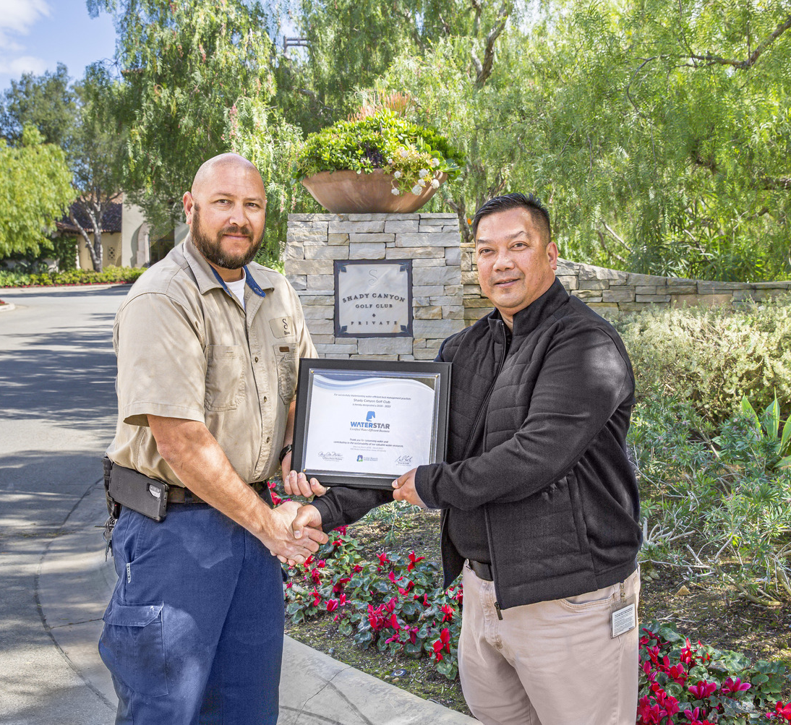
WaterStar Business Recognition Program
Recognizes water efficiency efforts of business and landscape customers
  WaterStar businesses featured on IRWD website and promoted through IRWD outreach materials
  Have use of WaterStar logo on their print materials and website
  First to know about new IRWD programs and incentives

Slide 5
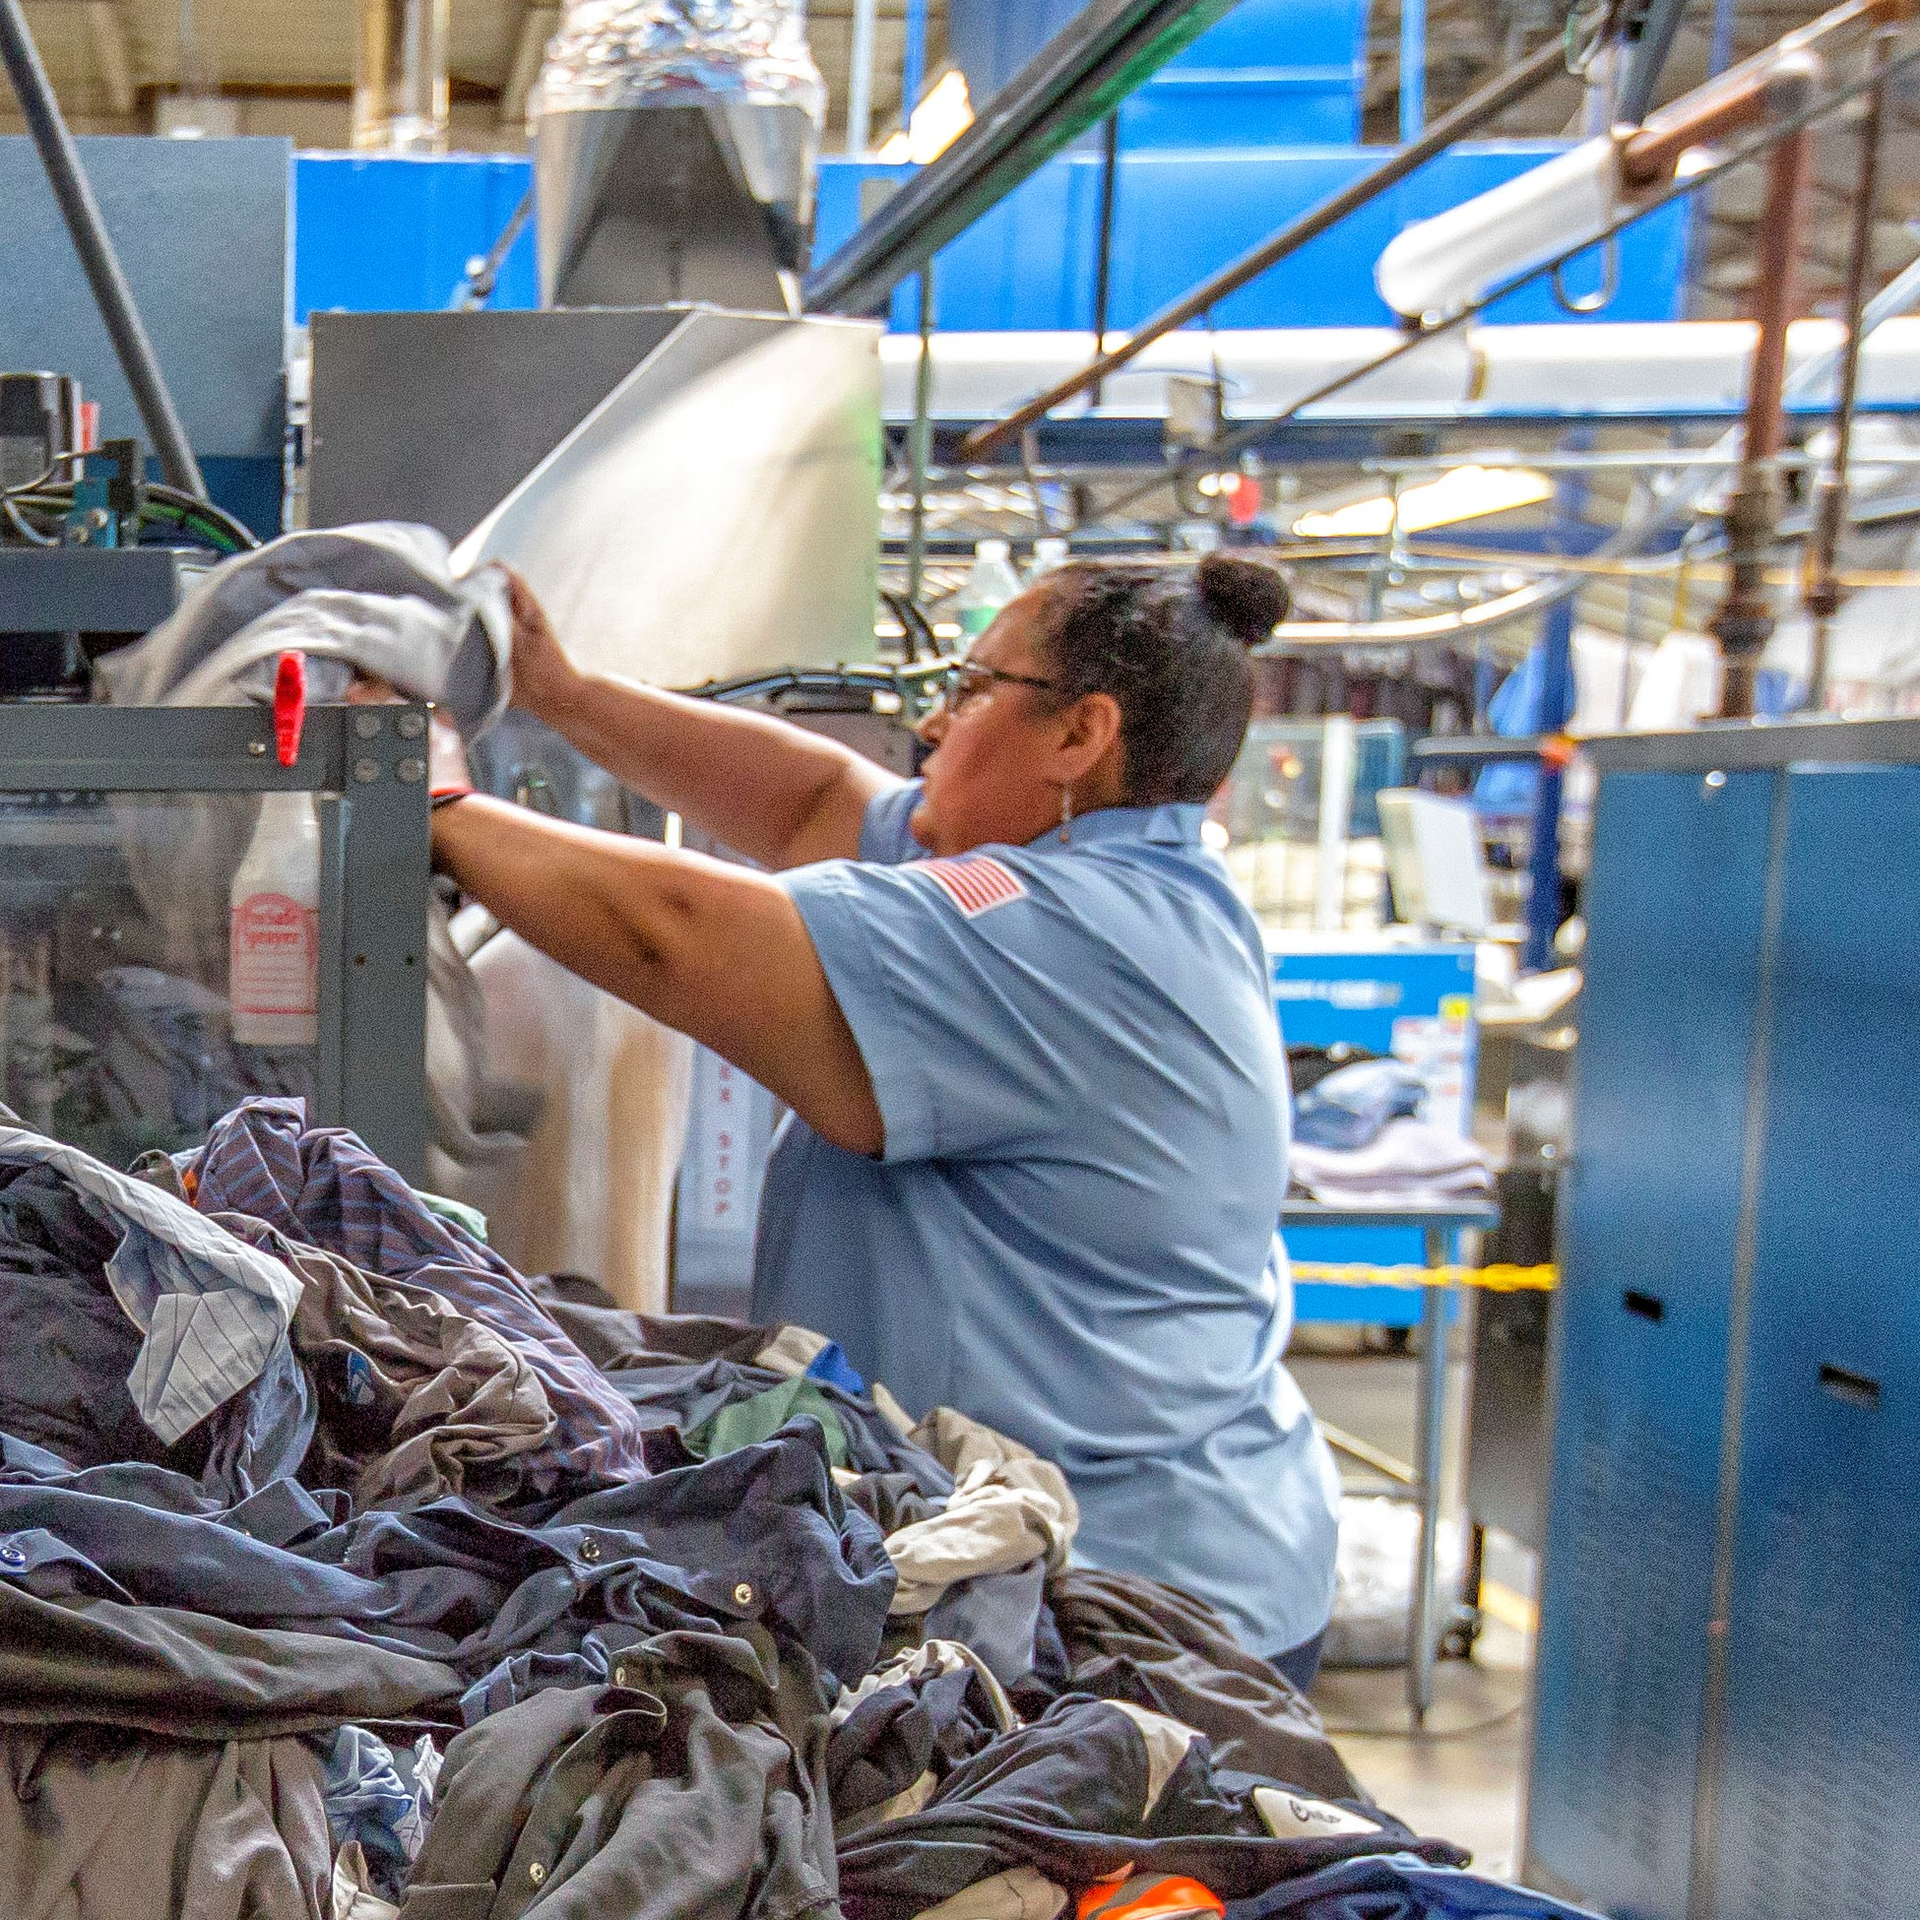
WaterStar Program Incentives
Rebates
  Plumbing fixtures
  Irrigation equipment
Free faucet aerators
Free site survey
Free water use reports
  Monitor trends
  Calculate savings
Notes:
For instance, Canon USA installed water-efficient faucets, toilets and shower heads. They use recycled water for outdoor irrigation. Canon’s commitment to water efficiency has resulted in saving more than 7 million gallons of water each year.
And that has saved them over $15,000 annually.

Slide 6
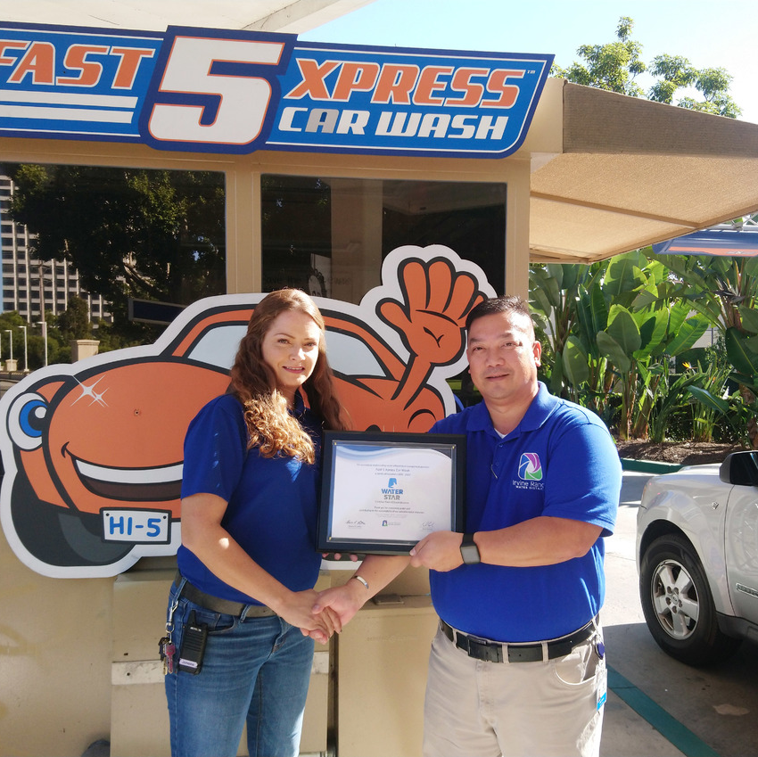
Eligible Businesses
Plumbing fixtures comply with California plumbing code
Process water use efficiency
Irrigation system complies with Model Water Efficient Landscape Ordinance
Use of recycled water

Slide 7
WaterStar Businesses
Saving 482 million gallons a year combined
Shady Canyon Golf Club
UC Irvine
Tierra Verde Industries
Capital Group
KIA Motors America (HQ)
KIA Design Center
Fast 5Xpress Car Wash
Canon USA
Checkered Flag Express Car Wash
Hoag Hospital
Great Park Ice and 5 Point Arena
Prudential Overall Supply
Chapman University
Shimano USA
Abbott
Parker Meggitt
Karma Automotive
Masimo
Hyatt House
Kawasaki Motors USA
Simpson Chevrolet of Irvine
Imuraya USA
BCD Tofu House
Between the Rinks
Cucina Enoteca

Slide 8

Current & Upcoming Projects

Slide 9
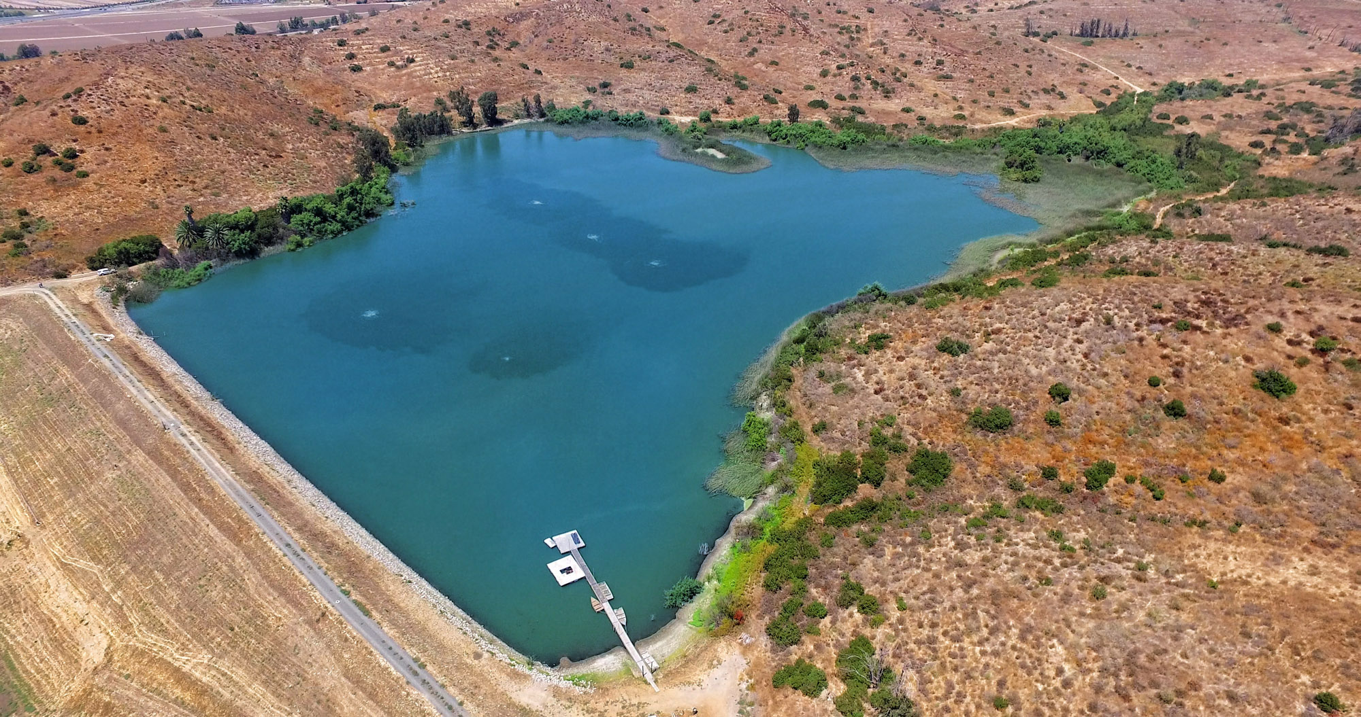

Engineering
Syphon Reservoir Improvement Project
Investment to increase capacity 10-fold
Allow IRWD to store more recycled water to meet seasonal and future needs
Reduce dependence on costly imported water
Make community more self-sufficient
Protect against droughts
syphonreservoirproject.com

Slide 10
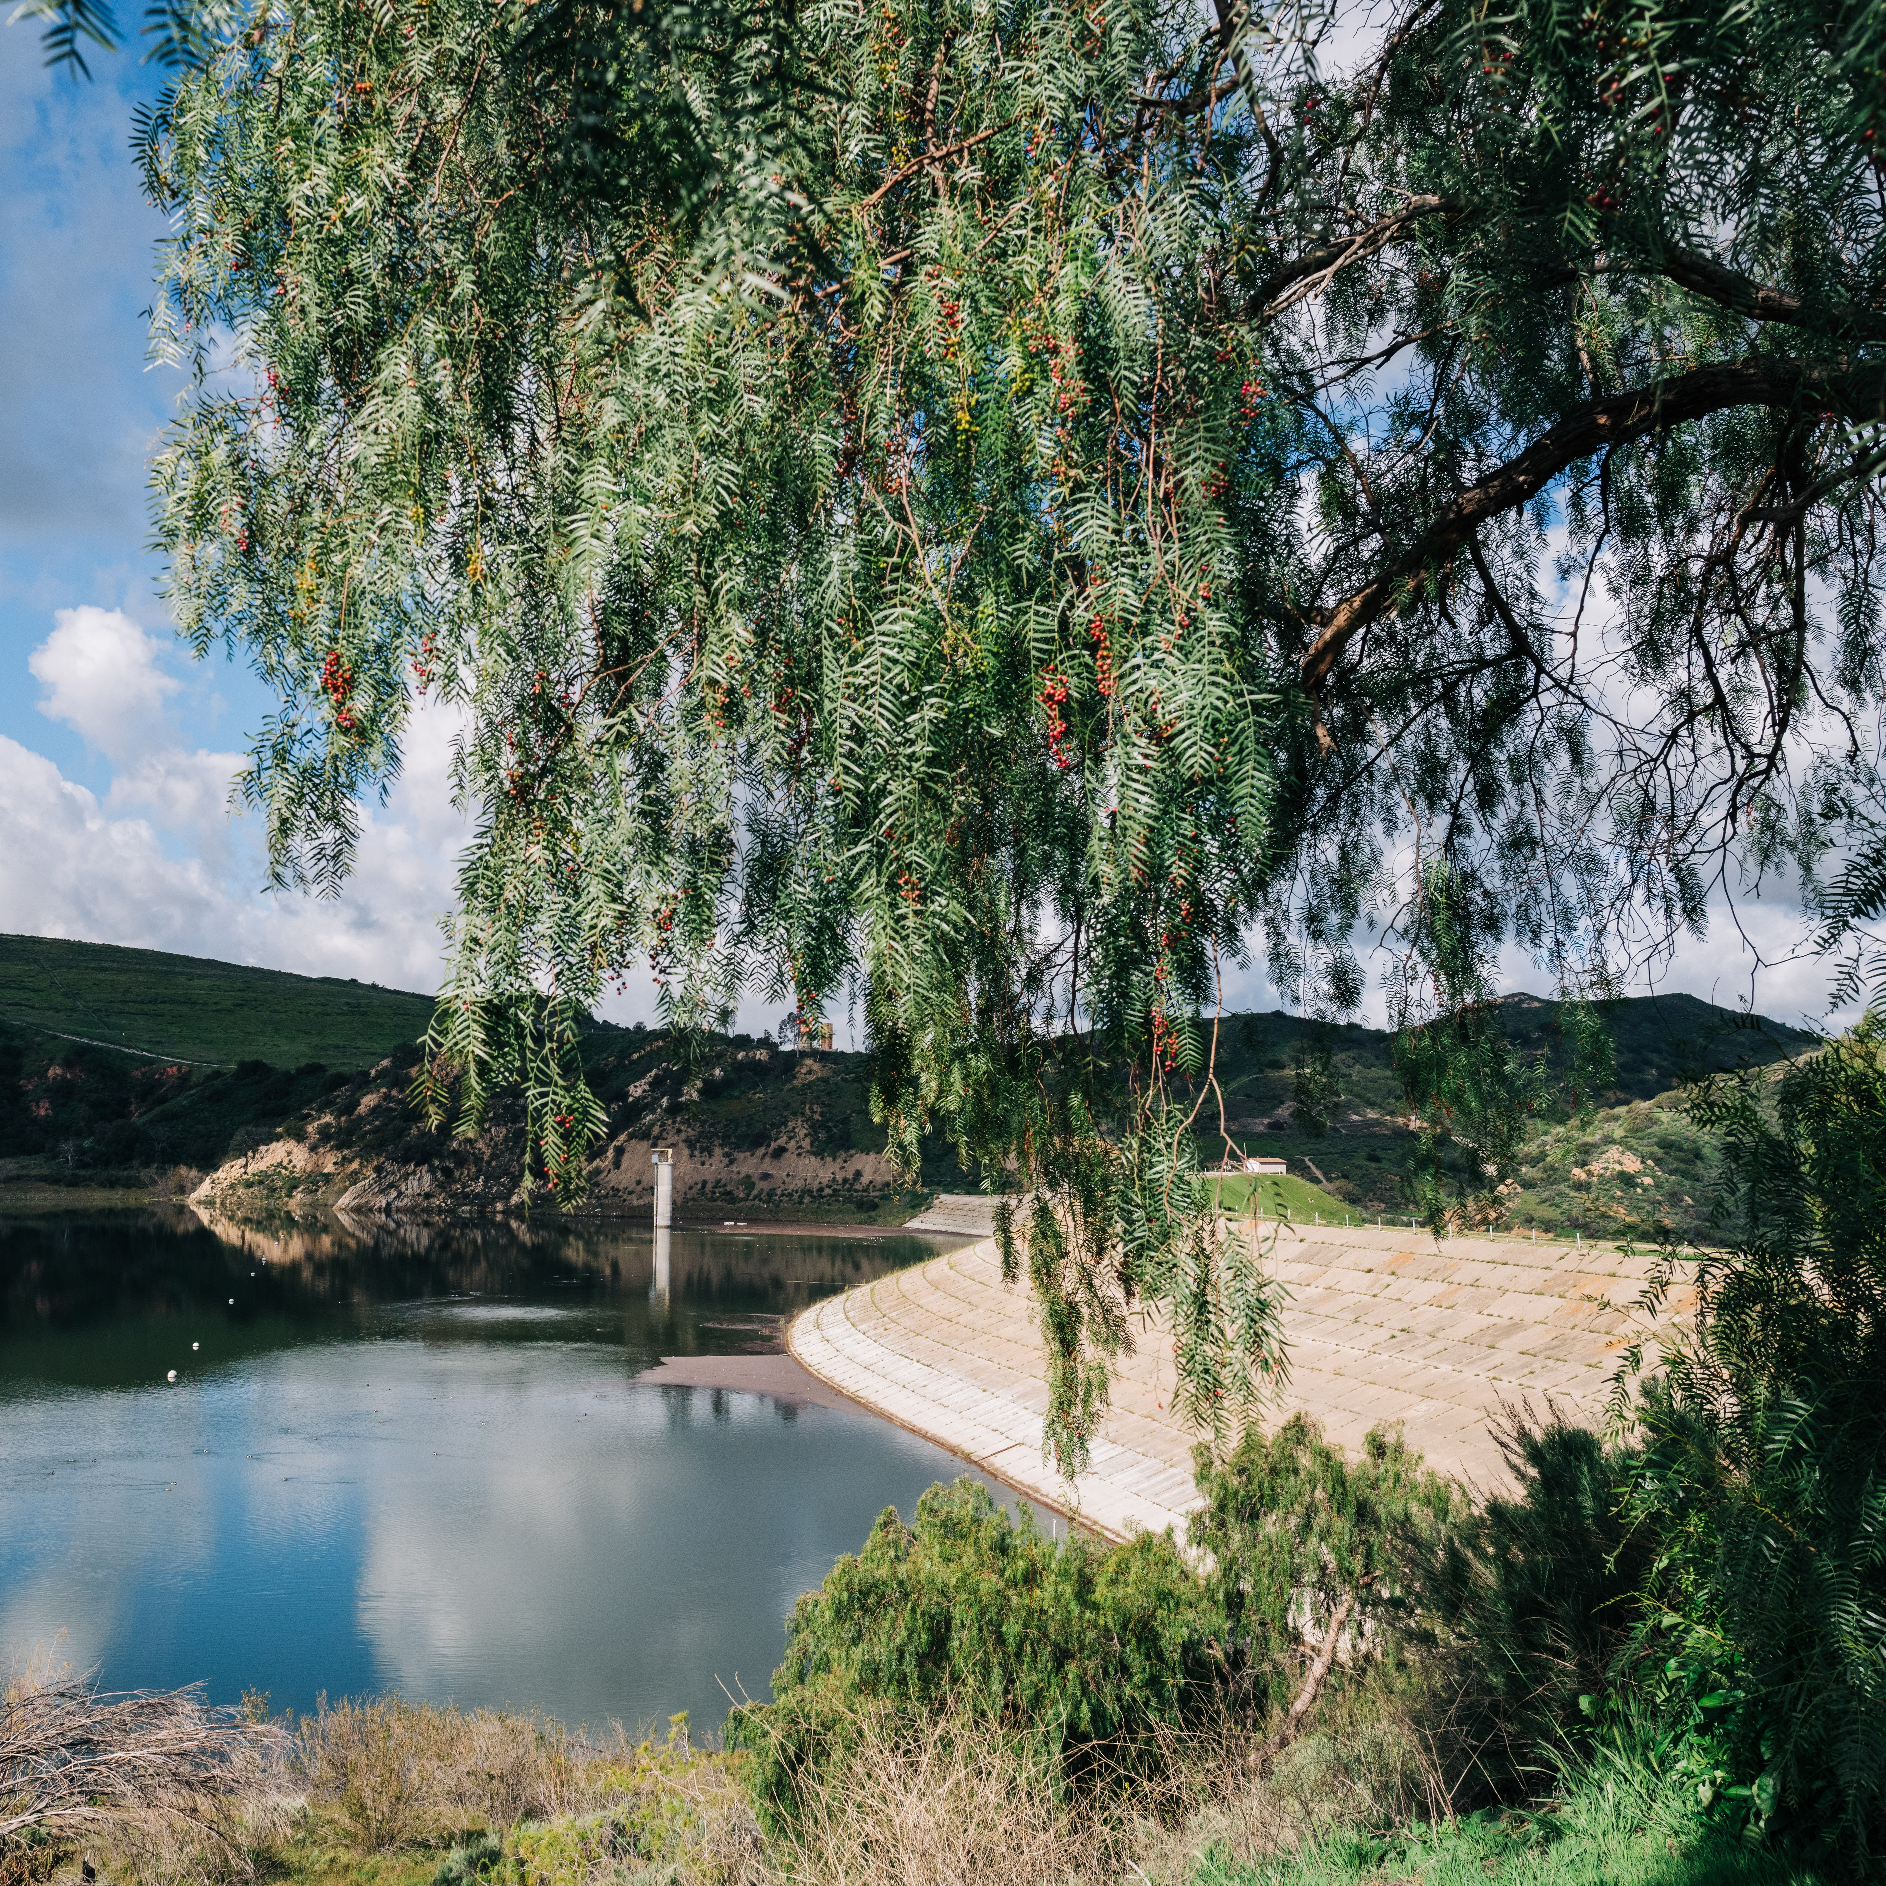

Engineering
Irvine Lake Improvement Project
Replace outlet tower and spillway at Santiago Creek Dam
Restore lake to full capacity
Will be designed using Risk Informed Decision Making
  Rigorous, systematic, thorough approach to dam safety that identifies and reduces risks
  Above and beyond state standards
Overall safer facility that will increase reliability for years
irvinelakeproject.com

Slide 11
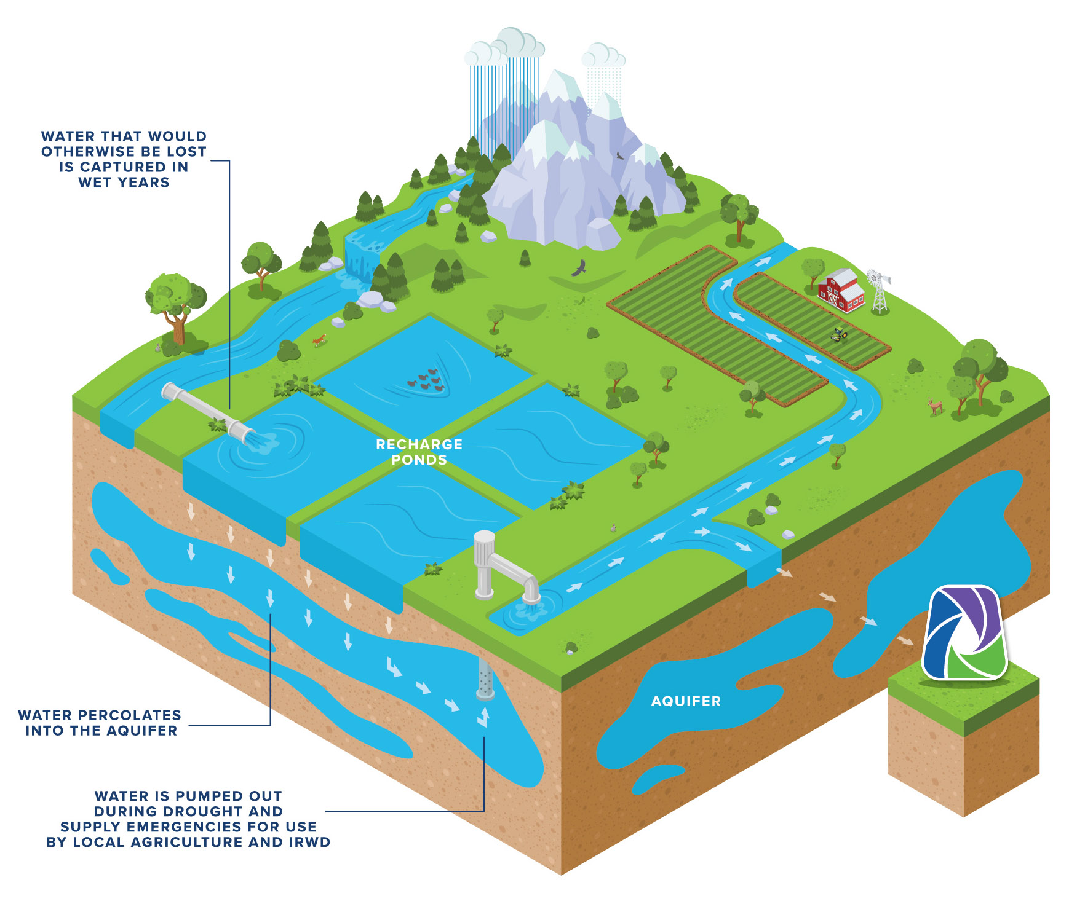

ENGINEERING
Kern Fan Groundwater Storage Project
Water banking project in Kern County
  500 cfs turnout and canal from California Aqueduct
  1200 acres of recharge basins
  12 groundwater wells
kernfanproject.com
Notes:
The importance of water banking.
Water banking adds to the District’s resiliency, storing water in wet years for use in emergencies.

Slide 12
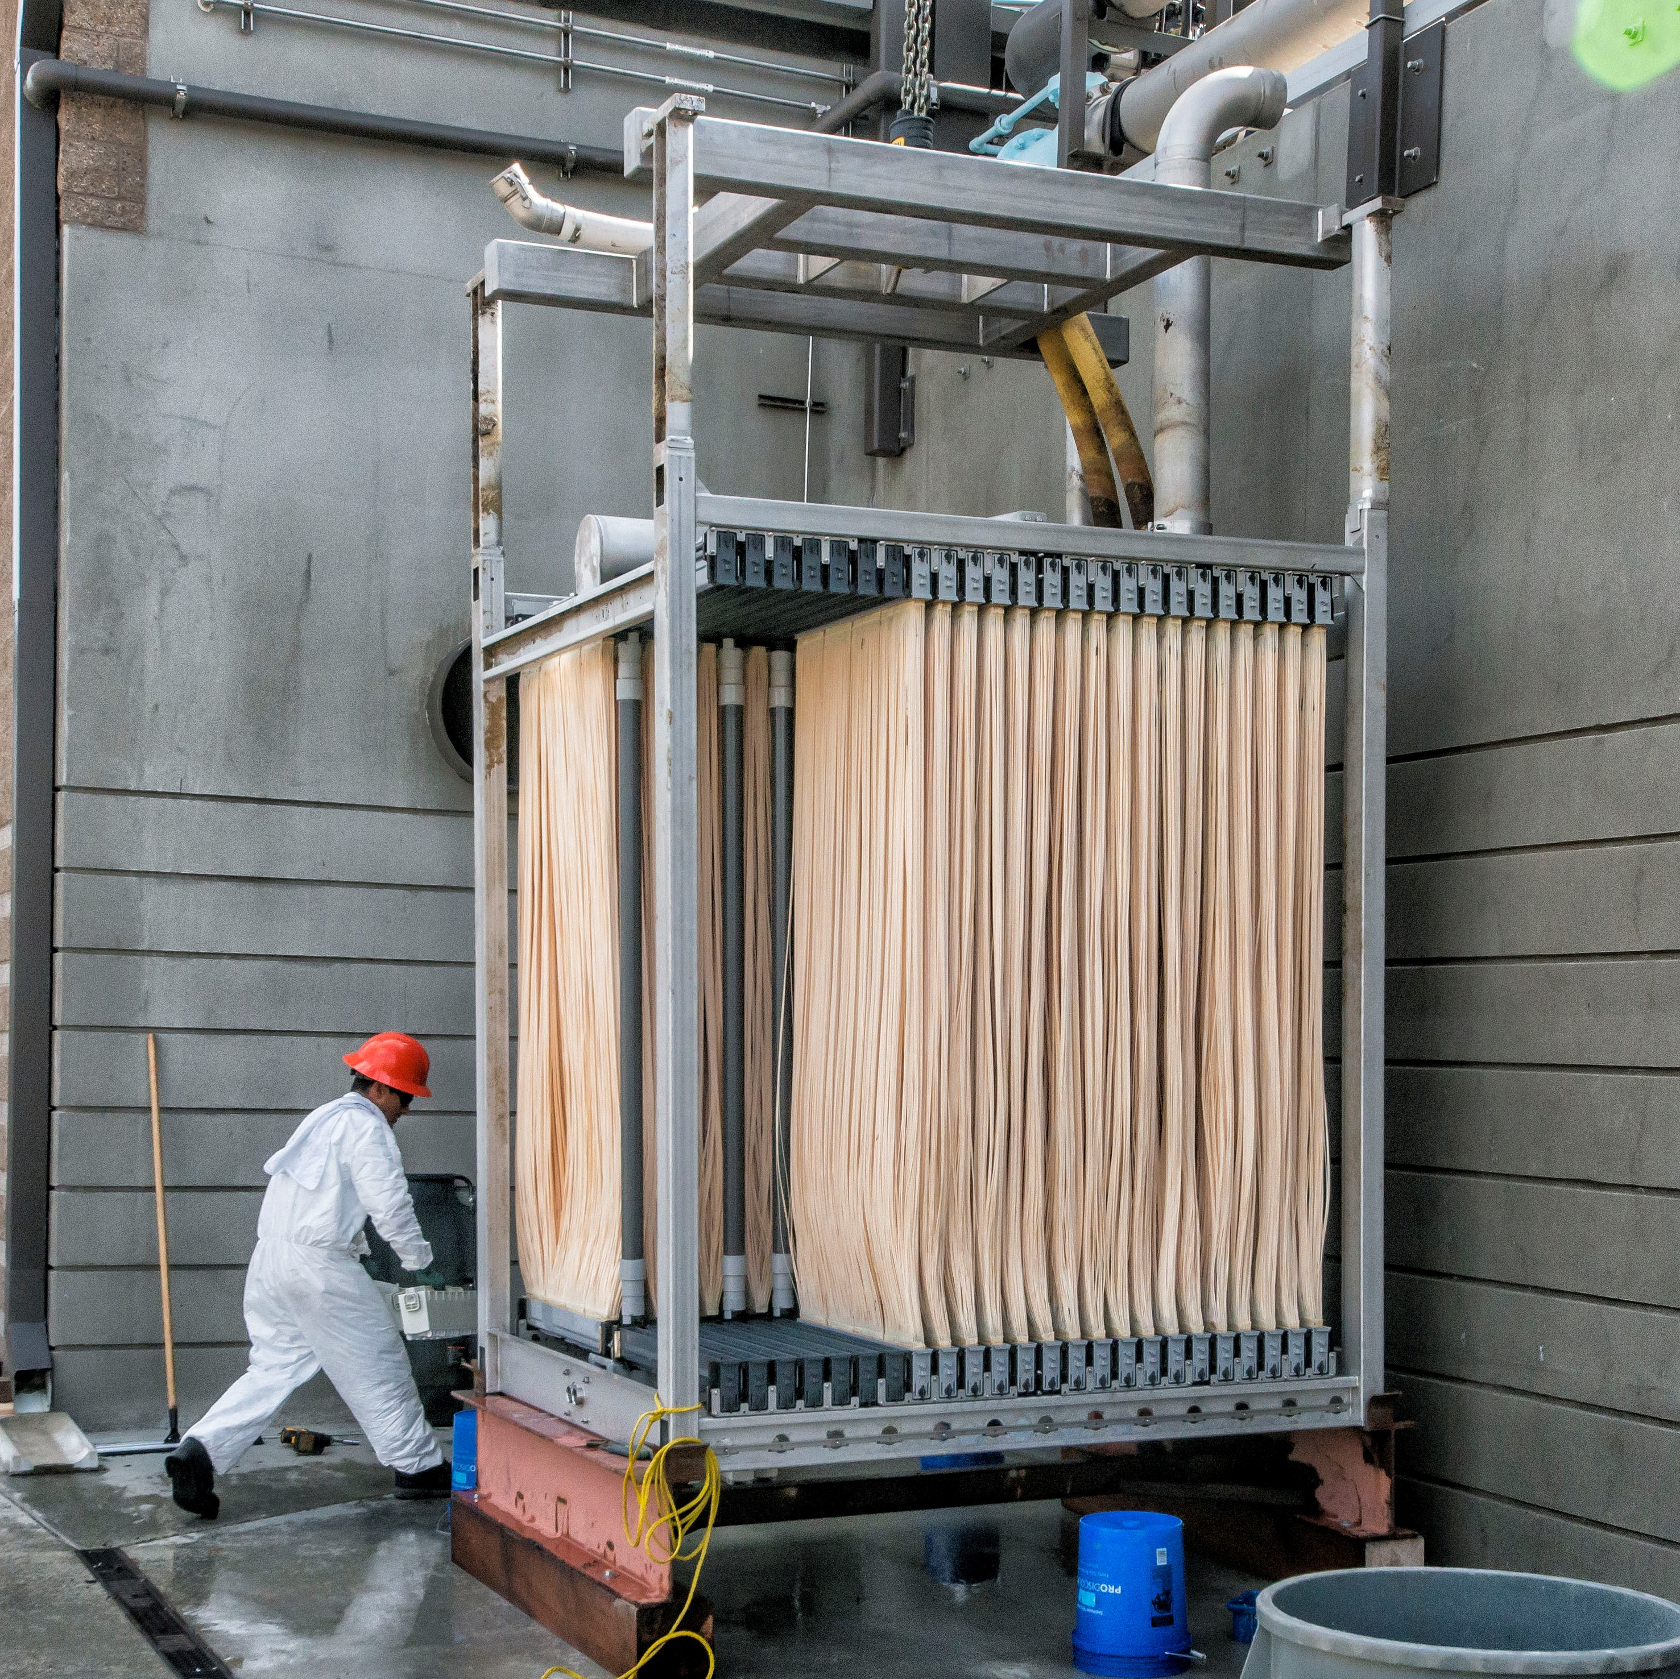
Engineering
Michelson Water Recycling Plant Phase 3 Expansion
Expand Membrane Bioreactor by adding a third MBR process train
  Biological treatment reactor, mixed liquor pump station, membrane tanks
Expand equipment building that houses permeate pumps and blowers
Evaluate alternatives for increased treatment capacity
  Through existing MBR process trains and/or conventional activated sludge facilities
Expand MWRP capacity from current 28 million gallons per day to 31 mgd

Slide 13

Finance & treasury
Banking depository services RFP
  Seeking depository services like remote deposit, lockbox services, and money market sweep vehicles for excess cash
Investment accounting & reporting software
  Seeking cloud-based software to simplify investment accounting, compliance, and risk reporting while reducing work required to process month-end, quarter-end and year-end close
  Reduce capital expenses and free up resources
  Leverage a cloud-based solution to reduce IT operating costs, improve data quality, speed reconciliation time, and reduce closing times

Slide 14
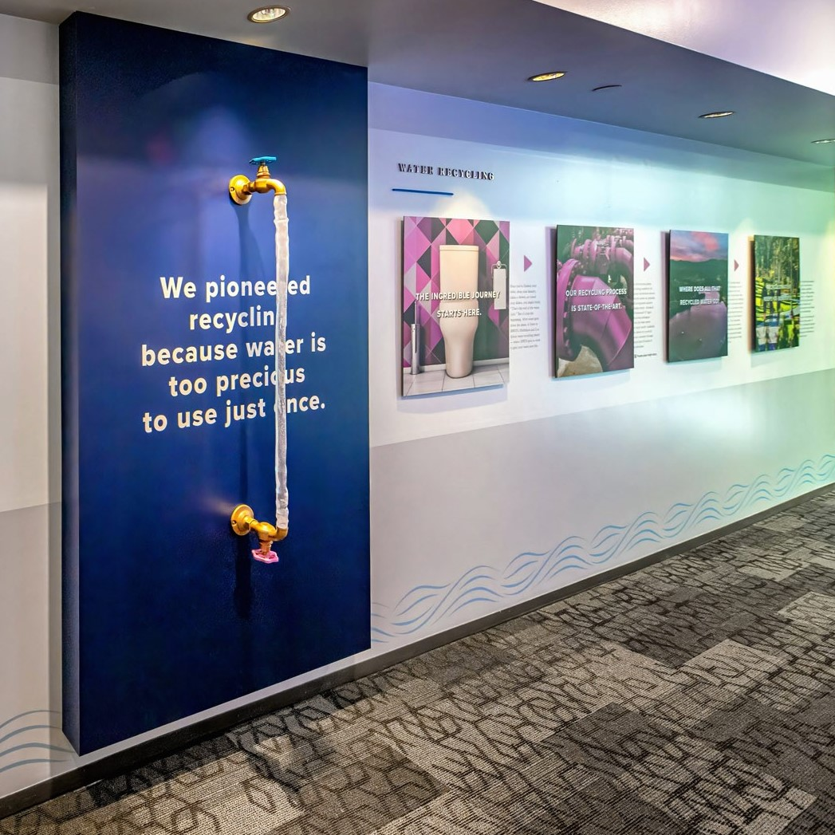
Communications
Educational displays
Produce displays for San Joaquin Marsh Wildlife Sanctuary visitors center
  Explain natural treatment and Marsh wildlife
Update signs at Marsh & office building
Website improvements
Create consolidated Save Water & Money section on IRWD.com
  Residential and commercial customers can easily navigate to find water savings
IRWD.com makeover: Easier to navigate, with important content front and center

Slide 15
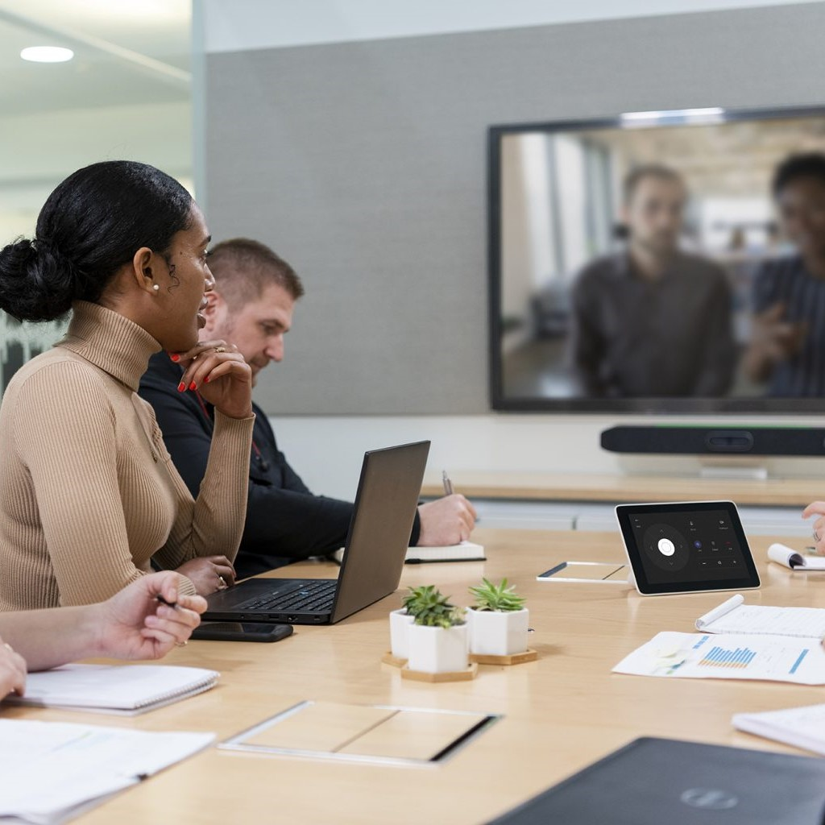
Information services
Audio-visual upgrades
Modernize AV capabilities in 10 conference rooms
Logitech Tap video-conferencing, monitors, cameras, mics, speakers, cabling, etc.
Computer network redesign and upgrade
Better support operations
Improve resilience, security, performance for field/mobile personnel, and integration

Slide 16

Information services
Microsoft Azure Active Directory
Migrate from the existing directory services
Microsoft Teams phone
Migrate from existing telephone system
Cybersecurity
Various efforts to continuously improve protections

Slide 17

THANK YOU!
Get
connected
Download today’s materials

